Slide 1
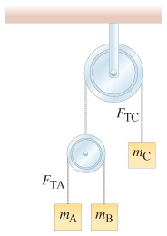
Homework 4
Due on 10/11/2018 for class meeting on Mon & Wed
Due on 10/11/2018 for class meeting on Tue & Thu
1. The double Atwood machine shown in figure has frictionless, massless pulleys and cords. Determine the acceleration of mass m_{A}, m_{B}, and m_{C}, and the tensions T_{A} and T_{C} in the cords. m_{A}= 2Kg, m_{B} = 1Kg and m_{C} = 3Kg
2. (A) As shown in Fig. 2(a) two identical (相同的) blocks A and B rest on a table top.
At t = 0 sec, a third block C is placed on top of these two blocks, as shown in Fig. 2(b). The masses of block A, B and C are M, M and 2M, respectively. If there is no friction between all contacting surfaces, determine the direction and the magnitude of the acceleration of block C.
(B) (8pts) As shown in Fig. 2(c) block C and block B are now placed on top of block D, and a constant force F drags the assembly toward the right to keep block B and block C resting on block D, with mass 8M. Let N₁ be the magnitude of the normal force between block D and block C, and N₂ the normal force between block B and block C. If again there is no friction between all surfaces in contact, determine the ratio N₁/N₂.(Draw the force diagram for each object in the problem)
45⁰
N₁
N₂
45⁰
Fig. 2(b)
Fig. 2(c)
Fig. 2(a)
C
C
D
B
F
A
B
A
B
45⁰

Slide 2
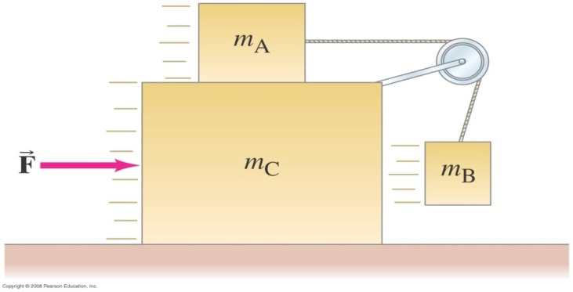
3. A system contains two small blocks (m₁ =2m₂) and a large block with mass M=4m₂ which rests on a horizontal table, as shown in Fig. 3. Assume m₂ does not make contact with M during the motion. There is no friction between m₁ and M and between M and the table. Ignore the masses of the pulley A and the sting connecting the two small blocks.
A
Table
Fig. 3
Draw the free body diagram for all three blocks and the pulley separately, label each force you draws with proper symbol (e.g., Mg, F, ... etc.)
Find the applied force F such that the block m₁ does not move relative to M. Write your answer in unit of m₁g (i.e., F/m₁g )
Find the angle θ for the motion in part (b).

Slide 3
Constrant: Because the lengths are constant.
寫下公式:
計算:
(1)+(2):
Relative to pulley A (static):
(2)*2+(3):
(4)*5+(5):
Relative to pulley C (moving):
,

Slide 4
(A)
y
N_{A}
y
y
N_{B}
N₂
N₁
y
x
x
x
x
C
N₁
Mg
A
B
2Mg
Mg
N₂
Block A
Block C
Block B
Block A,
Block C,
(5)
Block B,
(1)
(2)
(6)
(3)
(4)
(7)
Condition of motion:
(8)
(5),(8)→
(9)
(1),(7),(9)→
(10)
(6),(9),(10)→
(11)
(10)x2-(11)→
The acceleration of block C is g/2, moving downward.

Slide 5
Fig. X(c)
y
N₁
y
45⁰
y
N_{D}
N_{B}
N₂
C
F
x
x
D
B
F
x
N₁
N_{B}
2Mg
Mg
N₂
8Mg
Block D
Block C
Block B
Block D,
(1)
Block C,
Block B,
(2)
(5)
(3)
(6)
(4)
Conditions of motion:
(7)
(8)
(7),(3)→
(9)
(7),(5)→
(10)
(9),(10)→

Slide 6
m₁:
Pulley A:
m₂:
M:
Remaining variables and equations:

Slide 7
Remaining variables and equations:
(3)²+(4^)² :
(7) = (1^)² :
,

